Slide 1
Flight price prediction
submitted by : prince francis

Slide 2
Objective:
Development of a predictive model for flight prices.
Benefits
Prediction of Flight prices
Helps in easy flow for managing resources.
Data Sharing Agreement:
Sample File Name(prediction03162024__125310.csv)
Length of Date Stamp(8 digits)
Length of Time Stamp(6 digits)
Number of Columns
Column names
Column data type

Slide 3
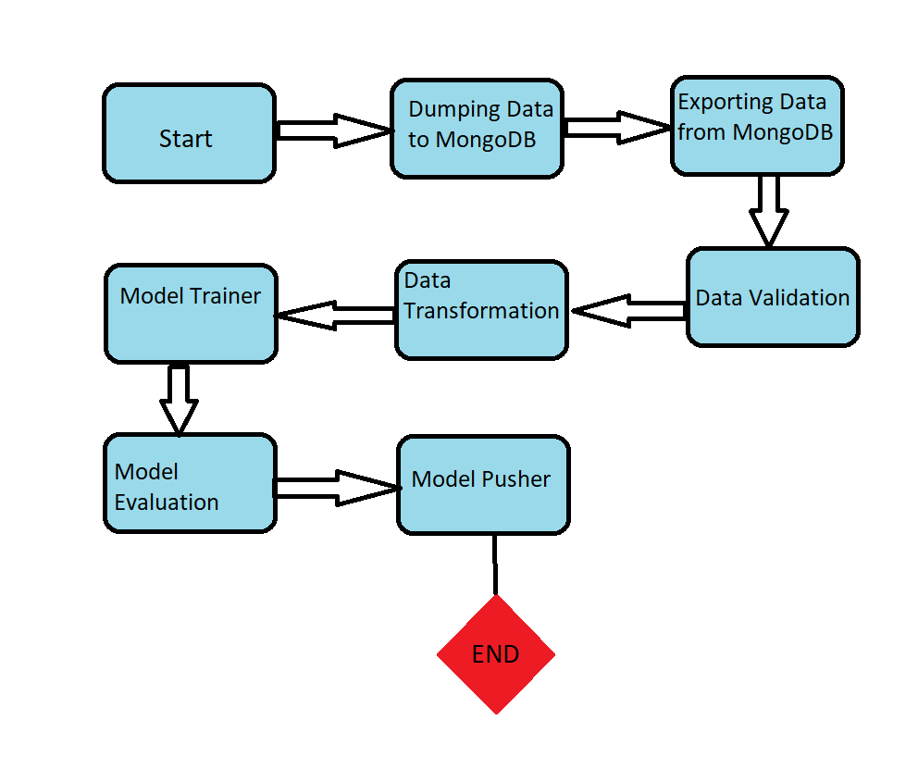
architecture

Slide 4
Data ingestion
Train dataset is being read from MongoDB. The retrieved dataset is being split into two parts i.e Train and Test set.
A folder known as artifact has been created. This is to store files and objects which is corresponding to each component.
Note: Each time the training pipeline is initiated it is being stored under a timestamp in the artifact folder.
Inside the timestamp data_ingestion folder is created. The complete dataset is being stored under subfolder feature_store and the split datasets are being stored under a different subfolder named datasets.

Slide 5
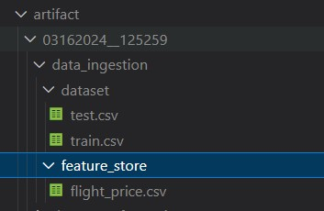
Data Ingestion(cont…)
Below represents the folder directory structure for the data_ingestion folder.

Slide 6
Data validation
In case of data validation we have set a threshold to drop the columns with null values above that threshold.
Then we are setting the complete train dataset as our base dataset.
This is to check if all the columns that are being present in the base dataset are also being there in the current dataset.
After that data drift is being initiated. This is being done using the chi2_contingency function. Data drift is to check if the distribution is equal for each column. This is done by comparing each column under the base dataset and against the same column in the split train and test dataset.
Finally the results of each operation is being printed in report.yaml file under the directory data_validation.

Slide 7
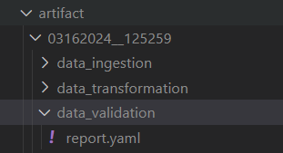
Data validation(contd..)
Below represents the folder directory structure for the data_validation folder

Slide 8
Data transformation
Data is being read from the feature store directory.
Rows will the null values are being dropped.
Then a function called feature_engineering has been called to transform the complete dataset. These include:
Changing the datatype of the respective columns into meaningful ones.
Dummy variable creation for categorical variables.
Label encoding for categorical variables.
Splitting Route column to each Routes.
Removing the original columns against which dummy variables were created.
We are then separating features into independent X and outcome variable y .
The output variable Price contains outliers which are being handled using the median.

Slide 9
Data transformation(contd…)
Using sklearn library we are splitting the X and y features into train and test set.
We are normalizing the dataset using the min_max_scaler.
PCA is performed over the top of these sets for dimentionality reduction.
In total we are getting 18 columns after PCA is performed.
After this we are storing the scaler object under the subfolder min_max which is under the folder data_transformation.
The PCA object is being stored in the subfolder pca.
The final datasets which are being split are being stored in the subfolders test_transformed_data and train_transformed_data.

Slide 10
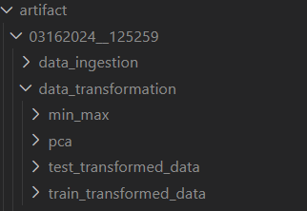
Data transformation(contd….)
Below represents the folder directory structure for the data_transformation folder

Slide 11
Model trainer
Since the data is being transformed we can now train the model.
We have chosen GradientBoostRegressor inorder to train the data.The model has been chosen after the evaluation of different regression models.
Firstly we are checking if the model is overfitting or underfitting.
Then we are doing hyperparameter tuning using RandomizedSearchCV.
The improved model object is being stored under the folder model_trainer.

Slide 12
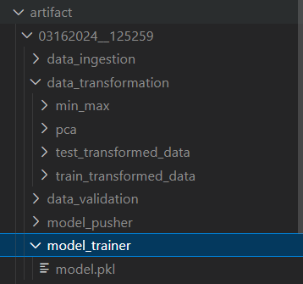
Model trainer(contd….)
Below represents the folder directory structure for the model_trainer folder.

Slide 13
Model evaluation
The main aim of this component is to check first if there is a folder named as saved_folders.
If yes, then we have to load all the scaler, pca and model objects from the latest folder available and check if the current model is performing better than the previous model or not. If yes, then only we will be pushing the current model components as an improved model.

Slide 14
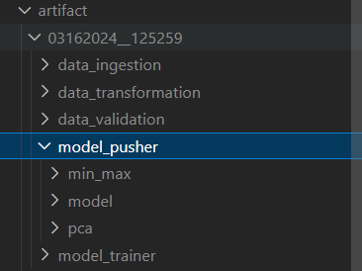

model pusher
If our current model is better than the previous model then we would be pushing the current model components to the folder saved_models.
The same components are also being pushed to the folder model_pusher under the subfolders min_max, model and pca.
Below figures represent the folder structure.

Slide 15
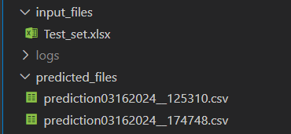
Batch prediction
input_files folder contains our test dataset named Test_set.xlsx
We would be doing batch prediction on this dataset and then saving our output in the folder named as predicted_files with timestamp.
Below folders represent the folder structures.

Slide 16
Q&A
Q1)What’s the source of the data?
The data for training is provided by the client in multiple batches and each batch contain multiple files.
Q2)What was the type of data?
The data was the combination of categorical and numerical values.
Q3)What’s the complete flow you followed in this project?
Refer Slide 3rd for better understanding.
Q4)How logs are managed?
We have created a separate logger.py file to manage log files. Logs are being stored in a separate folder named logs.

Slide 17
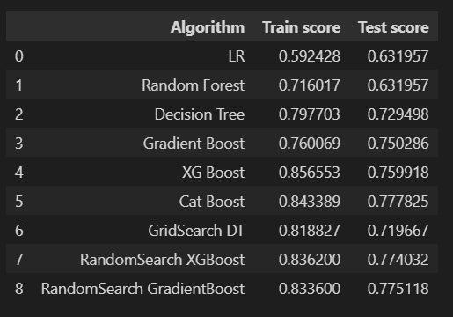
Q&A(contd…)
Q5) What models were being used before choosing one for training?
Q6) What are the different stages of deployment?
Once the project is being pushed on to github CI/CD cycle starts. Once on successful completion
Docker image is being pushed to aws ECR. Then, using the Apache airflow we can trigger the dags for training pipeline and batch prediction.

